Slide 1
Eorange Online Shopping During Covid-19 Pandemic Situation
Submitted By
Mohammed Samiul Mostafiz
18-37352-1
Department of EEE, American international university of Bangladesh (AIUB)

Slide 2
COVID-19
Covid-19 were reported on 8 March 2020
On 22 March, a 10 day shut down effective from the 26th of the month was declared

Slide 3
Introduction
WHAT IS ONLINE SHOPPING?

Slide 4
Benefits to Online Shopping
Usability and easy access
Better deals and savings rewards
Many retail stores offer promotions
Saves time
Larger stock to choose from
Product reviews
Comparison shopping

Slide 5
POPULAR ONLINE SHOPPING SITES
Walmart
Target
Etsy
Dell.com
JC Penny
QVC
EBAY
Best Buy

Slide 6
METHODOLOGY
Primary sources
Secondary sources

Slide 7
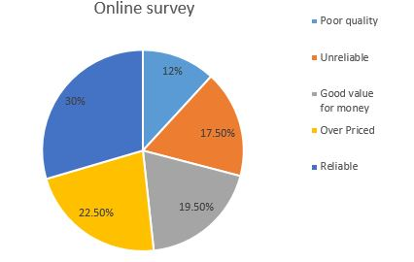
Result
My survey report:
Which of the following word would you use to describe Eorange.shop
product?
49 responses

Slide 8
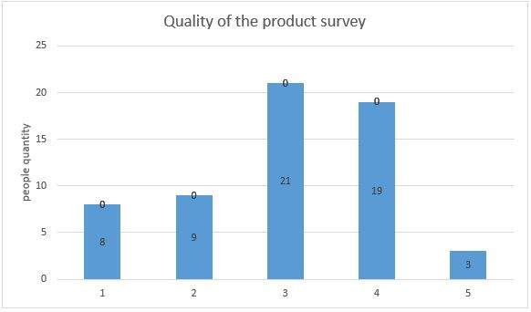
How would you rate the quality of the product?

Slide 9
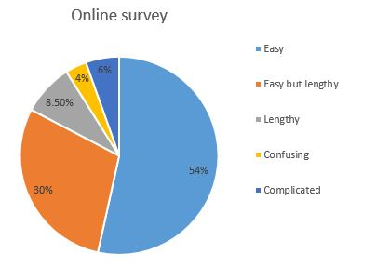
How will you describe the ordering method of Eorange.shop?

Slide 10
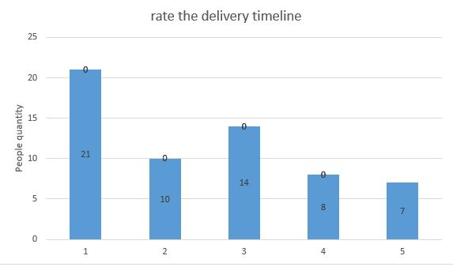
How will you rate the delivery timeline?

Slide 11
Conclusion

Slide 12
Thank you
Any Question?

